Slide 1

BASIC PRINCIPLES OF PROJECT MANAGEMENT
Prof. Nguyễn Văn Hùng

Slide 2
Lecture 2 – PART II
PROJECT MANAGEMENT BASICS
Chapter 1
Values, Needs, Phases of Project Management and
Steps in Managing of the Project

Slide 3
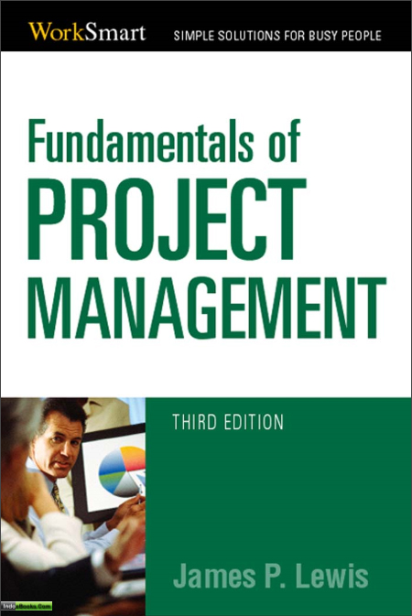

Slide 4
I -Value of Project Management
1- Evaluation of the implemented Projects
* The status of software Projects in United States
In the book “Fundamentals of project management”, the statistics of Joseph Heagney: about of software projects of Standish Group.
17% – successfully implemented.
50% – changed the targets (overspent).
33% – canceled.
In U.S – for one year: $250 billion for software development nationwide, $80 billion – lost, 83% – trouble.

Slide 5
I -Value of Project Management
1- Evaluation of the Implemented Projects
* The reasons why are projects failed :
Failure to align projects with organizational objectives
Poor scope
Unrealistic expectations
Lack of executive sponsorship
Lack of project management
Inability to move beyond individual and personality conflicts
Politics

Slide 6
I -Value of Project Management
1 - Evaluation of the Implemented Projects
* The reasons why projects successfully implemented :
Project sponsorship at executive level
Good project charter
Strong project management
The right mix of team players
Good decision making structure
Good communications
Team members are working toward common goals

Slide 7
I -Value of Project Management
2-Value of Project Management
* Project management is, in fact, shorthand for project, program and portfolio management. And more companies are clearly seeing the payoff from investing time, money and recources to build organizational project management expertise : lower costs, greater efficiencies, improved customer and stakeholder satisfaction, and greater competitive advantage.
An Economist Intelligence report showed that 80 percent of global executives believed having project management as a core competency helped them remain competitive during the recession.

Slide 8
I -Value of Project Management
The delivery of business outcomes is realized through the success of projects, and in essence that is the way that project management strategies drive organizational success.
A survey by consulting giant McKinsey & Co. found that nearly 60 percent of senior executives said building a strong project management discipline is a top-three priority for their companies as they look to the future.

Slide 9
II. The Need of Project Management
1- Definition of Project Management
PROJECT MANAGEMENT is application of knowledge, skills, tools, and techniques to project activities to achieve project requirements.
PROJECT MANAGEMENT is accomplished through the application and integration of the project management processes of initiating, planning, executing, monitoring and controlling, and closing.

Slide 10
II. The Need of Project Management
2-The need of Project management
* Leading organizations across sectors and geographic borders have been steadily embracing project management as a way to control spending and improve project results.
When the recession began, this practice became even more important. Executives discovered that adhering to project management methods and strategies reduced risks, cut costs and improved success rates—all vital to surviving the economic crisis.

Slide 11
II. The Need of Project Management
* Good project management discipline stopped us from spending money on projects that fail,” says Ron Kasabian, general manager at global IT giant Intel, Folsom, California, USA.
In State of the PMO 2010 :
84 percent of the 291 project professionals responding said their companies have a PMO, demonstrating steady growth from 77 percent in 2006 and 47 percent in 2000.

Slide 12
II. The Need of Project Management
* Project Management role for the Competitive advantage
According to the Economist Intelligence Unit survey :
- 90% of global senior executives ranked project management methods as either critical or somewhat important to their ability to deliver successful projects and remain competitive.
- “A strong project management discipline brings exceptional value to the business, because when there is a demand for a product, we are the ones who deliver it,”
- “We are a key part of the business, and we adhere to the same rules, rigor and commercial goals as the rest of the organization.”

Slide 13
II. The Need of Project Management
PROJECT MANAGEMENT IN ACTION
-The strategy and vision of the organization is linked to the execution of these projects. We need to have a strong level of project management discipline and capability to meet those expectations .
-The project management approach creates a consistent level of governance, leadership, monitoring and reporting for projects, but eliminates much of the bureaucracy and paperwork that could otherwise slow the project team.

Slide 14
II. The Need of Project Management
* Building Project Management
Capabilities
Harnessing the potential of project management doesn’t happen over night, and it cannot be confined to the project team.
Organizations must actively work to shape mature project management practices and integrate it across all levels of the organization.

Slide 15
II. The Need of Project Management
Managing what’s measured.
The way to get the most value out of a project management methodology is through metrics, says Mr. Brodnik. “Focus on measures and processes tied to business goals, collect the data and make it available to everyone,” he says. “When people know what’s being watched, the put more time and focus
Use metrics to align projects with strategy. All project metrics and data regarding the project’s timeline, risks and progress should be made available to senior management in an at-a-glance format, says Mr. Romero.
“ When the executive team can see what’s going on with project , it is very helpful for strategic planning.”

Slide 16
II. The Need of Project Management
- Get everyone on board. Project management doesn’t happen in a bubble. It must be a collaborative effort that extends to the contractors, vendors and clients working on a project, says Mr. Buisson.
“Everyone we work with must subscribe to the quality, safety and value metrics we use to track projects.”
- Secure buy-in. Unless everyone in the company believes in the value of project management, the organization won’t be able to on it.”

Slide 17
II. The Need of Project Management
3-The rules of Project management
The first rule of project management is that the people who must do the work should help plan it.
“Leadership is the art of getting others to want to do something that you believe should be done.” —Vance Packard
It Is Not Just Scheduling!

Slide 18
II. The Need of Project Management
One-Person Projects
One-person projects do require good self-management, or good time management, but all you need is a good to-do list, which comes from a task listing. However, unless you are coordinating the work of other people, you aren’t practicing true project management.

Slide 19
II. The Need of Project Management
The Big Trap—Working Project Managers
It is common to have individuals serve as project managers and require also that they do part of the actual work in the project. This is a certain prescription for problems. If it is a true team, consisting of several people, the project manager inevitably ﬁnds herself torn between managing and getting her part of the work done. Naturally, the work must take precedence, or the schedule will slip, so she opts to do the work. That means that the managing does not get done. She hopes it will take care of itself, but it never does. After all, if the team could manage itself, there would be no need for a project manager in the ﬁrst place (remember our argument about whether project management matters?).

Slide 20
II. The Need of Project Management
RELATIONSHIP of THE PROJECT CONTRAINTS
One of the common causes of project failures is that the project sponsor demands that the project manager must ﬁnish the job by a certain time, within budget, and at a given magnitude or scope, while achieving speciﬁc performance levels. In other words, the sponsor dictates all four of the project constraints. This doesn’t work.
The relationship among the QCTS constraints can be written as follows:
C = f(Q, T, S)
In words, this says, “Cost is a function of Quality, Time, and Scope.” Graphically, I like to show it as a triangle, in which Q, C, and T are the sides and S is the area.

Slide 21
II. The Need of Project Management
In geometry, we know that if we are given values for the sides of a triangle, we can compute the area. Or, if we know the area and the length of two sides, we can compute the length of the remaining side. This translates into a very practical rule of project management: The sponsor can assign values to any three variables, but the project manager must determine the remaining one.

Slide 22
II. The Need of Project Management
Time
Scope
Quality
Cost
Triangles showing the relationship between Q, C, T, and S.

Slide 23
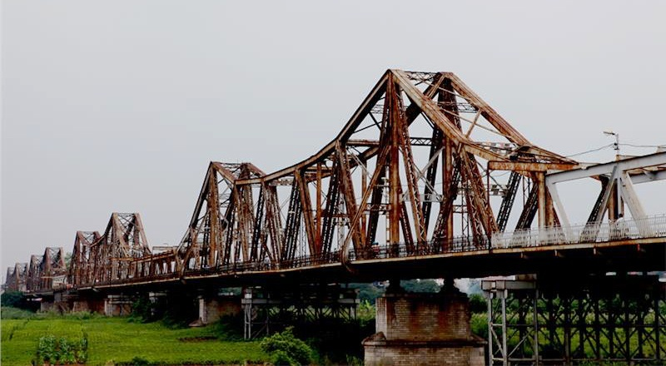
Long Bien Bridge
The bridge was built in 1899–1902 by the architects Daydé & Pillé of Paris, and opened in 1903.
Budget estimation (accepted): 5.390.794 Franc.
Overspent: 6.200.000 Franc.
Time of construction: 4 years (1898–1902) – (estimated: 5 years).

Slide 24

1. University for Science and Technology of Ha Noi (USTH)
The Bilateral project for Education and Training based on Intergovermental Agreement between Viet Nam and France:
“Establishment and Development of University for Science and Technology of Ha Noi”
Budget for Hoa Lac Campus: 213$ – LOAN ADB –
Time: 10 years (2009–2019)
Budget – ODA from France: 100 Million Euros.
ODA (non-returned).

Slide 25
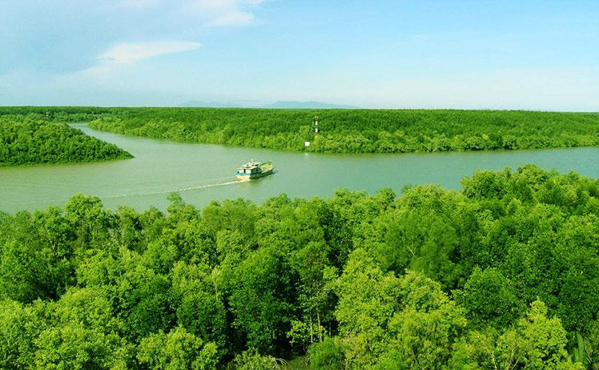
Can Gio Mangrove biosphere reserve

Slide 26
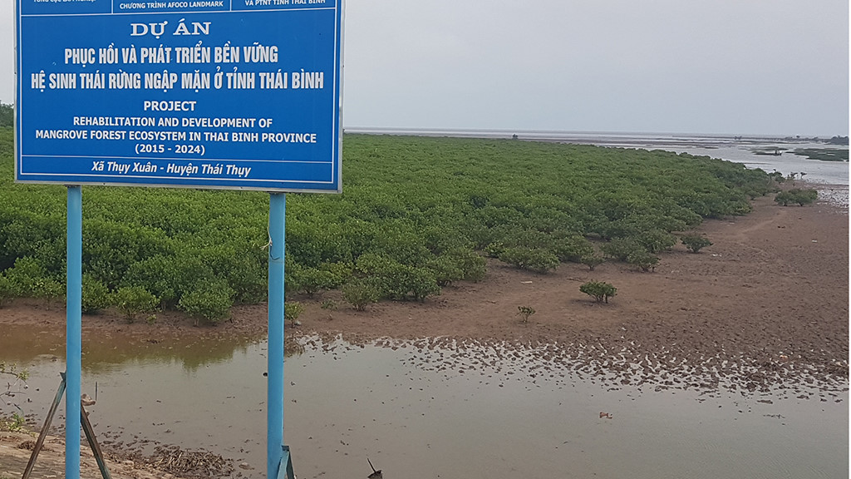
Project on rehabilitation and development of mangrove forest ecosystem in Thai Binh province

Slide 27
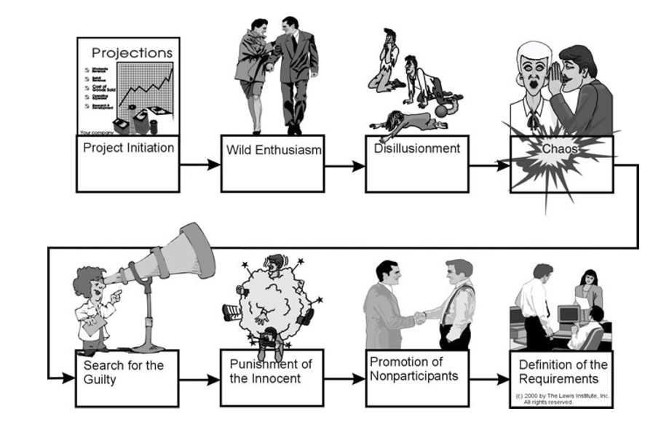
III. The Phases of a Project
Life cycle of a troubled project.

Slide 28
The Basic Phases of Project Management
  Project conception and initiation
An idea for a project will be carefully examined to determine whether or not it benefits the organization. During this phase, a decision making team will identify if the project can realistically be completed.
2. Project definition and planning
A project plan, project charter and/or project scope may be put in writing, outlining the work to be performed. During this phase, a team should prioritize the project, calculate a budget and schedule, and determine what resources are needed.

Slide 29
The Basic Phases of Project Management
3. Project launch or execution
Resources' tasks are distributed and teams are informed of responsibilities. This is a good time to bring up important project related information.
4. Project performance and control
Project managers will compare project status and progress to the actual plan, as resources perform the scheduled work. During this phase, project managers may need to adjust schedules or do what is necessary to keep the project on track.

Slide 30
The Basic Phases of Project Management
5. Project close
After project tasks are completed and the client has approved the outcome, an evaluation is necessary to highlight project success and/or learn from project history.
Projects and project management processes vary from industry to industry; however, these are more traditional elements of a project. The overarching goal is typically to offer a product, change a process or to solve a problem in order to benefit the organization.

Slide 31
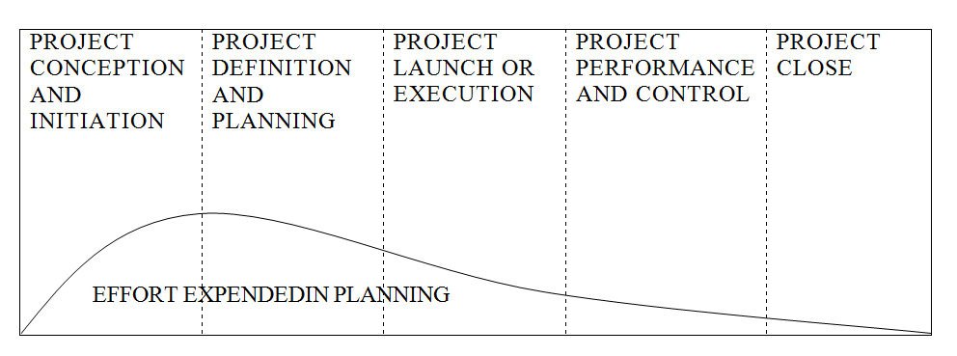
Appropriate project life cycle.

Slide 32
The core components of project management are:
defining the reason why a project is necessary
capturing project requirements, specifying quality of the deliverables, estimating resources and timescales
preparing a business case to justify the investment
securing corporate agreement and funding
developing and implementing a management plan for the project
leading and motivating the project delivery team;
managing the risks, issues and changes on the project
monitoring progress against plan
managing the project budget
maintaining communications with stakeholders and the project organization
provider management .
closing the project in a controlled fashion when appropriate.

Slide 33
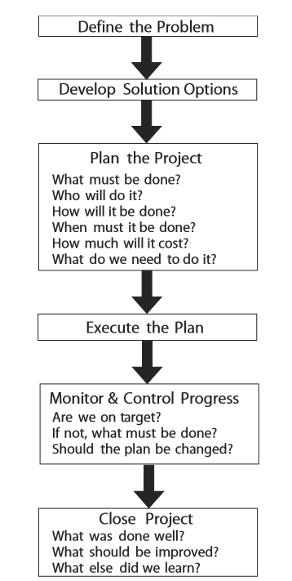
IV. The Steps in Managing a Project

Slide 34
Define the Problem
As was discussed previously, you need to identify the problem to be solved by the project. It helps to visualize the desired end result. What will be different? What will you see, hear, taste, touch, or smell? (Use sensory evidence if things can’t be quantiﬁed.) What client need is being satisﬁed by the project?
Sự xác định rõ nhiệm vụ của Dự án

Slide 35
Develop Solution Options
How many different ways might you go about solving the problem? Brainstorm solution alternatives (you can do this alone or as a group). Of the available alternatives, which do you think will best solve the problem? Is it more or less costly than other suitable choices? Will it result in a complete or only a partial ﬁx?
Triển khai giải pháp lựa chon

Slide 36
Plan the Project
Planning is answering questions: what must be done, by whom, for how much, how, when, and so on. Naturally, answering these questions often requires a crystal ball. We discuss these steps in more detail in Chapters 2 through 4
Lập kế hoạch Dự án.

Slide 37
Execute the Plan
Obviously , Once the plan is drafted, it must be
implemented. Interestingly, we sometimes ﬁnd people going to great effort to put together a plan, then failing to follow it.
If a plan is not followed, there is not much point in planning, is there?
Thực hiện kế hoach

Slide 38
Monitor and Control Progress
- Plans are developed so that you can achieve your end result successfully. Unless progress is monitored, you cannot be sure you will succeed. It would be like having a roadmap to a destination but not monitoring the highway signs along the way.
- Of course, if a deviation from the plan is discovered, you must ask what must be done to get back on track, or—if that seems impossible—how the plan should be modified to reflect new realities.
Khảo sát và kiểm tra quá trình thực hiện Dự án

Slide 39
Close the Project
- Once the destination has been reached, the project is ﬁnished, but there is a ﬁnal step that should be taken. Some people call it an audit, others a postmortem (sounds a bit morbid, doesn’t it?). Whatever you call it, the point is to learn something from what you just did. Note the way the
- Questions are phrased: What was done well? What should be improved? What else did we learn? We can always improve on what we have done. However, asking “What did we do wrong?” is likely to make people a bit defensive, so the focus should be on improvement, not on placing blame. More on this later.
Kết thúc Dự án

Slide 40
V-THE PROJECT MANAGEMENT BODY OF KNOWLEDGE
The Project Management Institute has attempted to determine a minimum body of knowledge that is needed by a project manager in order for him or her to be effective.
Kiến thức Chuẩn mực về quản lý Dự án

Slide 41
PROJECT PROCESS
Broadly speaking , however , they tend to be employed in the sequence listed as the project progresses. That is, initiating is done ﬁrst, then planning, then executing, and so on.
In the event that a project goes off course, replanning comes into play, and if a project is found to be in serious trouble, it may have to go all the way back to the initiating process to be restarted.
Các quá trình của Dự án

Slide 42
Initiating
Once a decision has been made to do a project, it must be initiated or launched. There are a number of activities associated with this.
One is for the project sponsor to create a project charter, which deﬁnes what is to be done to meet the requirements of project customers. This is a formal process that is often omitted in organizations.
The charter should be used to authorize work on the project; deﬁne the authority, responsibility, and accountability of the project team; and establish scope boundaries for the job.
When such a document is not produced, the team members may misinterpret what is required of them, and this can be very costly.
Sự khởi động Dự án

Slide 43
Planning
One of the major causes of project failures is poor planning.
Actually, most of the time the problem is caused by there being no planning! The team simply tries to “wing it,” to do the work without doing any planning at all.
As it is explained earlier in this chapter, many of us are task oriented, and we see planning as a waste of time, so we would rather just get on with the work. As we will see when we turn to controlling the project, failing to develop a plan means that there can be no actual control of the project. We are just kidding ourselves (cited from Fundamentals Of Project Management )
Kế hoạch thực hiện Dự án

Slide 44
Executing
There are two aspects to the process of project execution. One is to execute the work that must be done to create the product of the project. This is properly called technical work, and a project is conducted to produce a product. Note that we are using the word “product” in a very broad sense. A product can be an actual tangible piece of hardware or a building. It can also be software or a service of some kind. It can also be a result—consider, for example a project to service an automobile that consists of changing the oil and rotating the tires. There is no tangible deliverable for such a project, but there is clearly a result that must be achieved, and if it is not done correctly the car may be damaged as a result.
Quá trình thực hiên Dự án

Slide 45
Executing also refers to implementing the project plan. It is amazing to ﬁnd that teams often spend time planning a project, then abandon the plan as soon as they encounter some difﬁculty. Once they do this, they cannot have control of the work, since without a plan there is no control. The key is to either take corrective action to get back on track with the original plan or to revise the plan to show where the project is at present and continue forward from that point.

Slide 46
Monitoring and Controlling
Monitoring and controlling can actually be thought of as two separate processes, but because they go hand in hand, they are considered one activity. Control is exercised by comparing where project work is to where it is supposed to be, then taking action to correct for any deviations from target. Now the plan tells where the work should be. Without a plan, you don’t know where you should be, so control is impossible, by definition.
Theo dõi và quản lý công việc

Slide 47
Furthermore, knowing where you are is done by monitoring progress. An assessment of quantity and quality of work is made using whatever tools are available for the kind of work being done. The result of this assessment is compared to the planned level of work; if the actual level is ahead or behind of the plan, something will be done to bring progress back in line with the plan. Naturally, small deviations are always present and are ignored unless they exceed some pre-established threshold or show a trend toward drifting further off course.

Slide 48
Closing
In too many cases, once the product is produced to the customer’s satisfaction, the project is considered ﬁnished, or closed. This should not be the case. A ﬁnal lessons-learned review should be done before the project is considered complete. Failing to do a lessons-learned review means that future projects will likely suffer the same headaches encountered on the one just done.

Slide 49
VI- Knowledge Areas
As previously mentioned, the PMBOK® Guide identiﬁes nine knowledge areas that project managers should be familiar with in order to be considered professionals. These are as follows.
Lĩnh vực kiến thức về quản lý dự án

Slide 50
Project Integration Management
Project integration management ensures that the project is properly planned, executed, and controlled, including the exercise of formal project change control. As the term implies, every activity must be coordinated or integrated with every other one in order to achieve the desired project outcomes.
Quản lý tổng hợp Dự án ( Lĩnh vực )

Slide 51
Project Scope Management
Changes to project scope are often the factors that kill a project. Project scope management includes authorizing the job, developing a scope statement that will deﬁne the boundaries of the project, subdividing the work into manageable components with deliverables, verifying that the amount of work planned has been achieved, and specifying scope change control procedures. Project Time Management I consider this a bad choice of terms, as “time management” implies personal efforts to manage one’s time. Project time management speciﬁcally refers to developing a schedule that can be met, then controlling work to ensure that this happens! It’s that simple. Because everyone refers to this as scheduling, it should really be called schedule management. (I know, I may be booted out of PMI for such heresy!)
Quản lý Pham vi của Dự an

Slide 52
Project Cost Management
This is exactly what it sounds like. Project cost management involves estimating the cost of resources, including people, equipment, materials, and such things as travel and other support details. After this is done, costs are budgeted and tracked to keep the project within that budget.
Quản lý Chi phí Dự án

Slide 53
Project Quality Management
As I have commented earlier, one cause of project failure is that quality is overlooked or sacriﬁced so that a tight deadline can be met. It is not very helpful to complete a project on time, only to discover that the thing delivered won’t work properly! Project quality managementin cludes both quality assurance (planning to meet quality requirements) and quality control (steps taken to monitor results to see if they conform to requirements).
Quản Lý Chất lượng Dự án

Slide 54
Project Human Resources Management
Project human resources management, often overlooked in projects, involves identifying the people needed to do the job; deﬁning their roles, responsibilities, and reporting relationships; acquiring those people; and then managing them as the project is executed. Note that this topic does not refer to the actual day-to-day managing of people. The PMBOK® Guide mentions that these skills are necessary but does not attempt to document them. Given that these are the most important skills that a project manager must have, the PMBOK® Guide is deﬁcient in omitting them.
Quản lý nguồn nhân lực Dự án

Slide 55
Project Communications Management
As the title implies, project communications management involves planning, executing, and controlling the acquisition and dissemination of all information relevant to the needs of all project stakeholders. This information might include project status, accomplishments, and events that may affect other stakeholders or projects. Again, this topic does not deal with the actual process of communicating with someone. This topic is also mentioned but not included in the PMBOK® Guide.
- Plan communication Management
- Manage communication
- Control Communication

Slide 56
Project Risk Management
Project risk management is the systematic process of identifying, quantifying, analyzing, and responding to project risk. It includes maximizing the probability and consequences of positive events and minimizing the probability and consequences of adverse events to project objectives. This is an extremely important aspect of project management that sometimes is overlooked by novice project managers.

Slide 57
Project Procurement Management
Procurement of necessary goods and services for the project is the logistics aspect of managing a job. Project procurement management involves deciding what must be procured, issuing requests for bids or quotations, selecting vendors, administering contracts, and closing them when the job is ﬁnished.
- Contract or agreement ,Understanding,subcontract ,purchase order
- Documenting how to manage procurement in a project :Project procurement decision ,specifying approach….
- Conduct procurements : obtaining sellers …..
- Control procurement : managing procurement relationships ,correction contracts …….
- Close procurements : completing each procurement

Slide 58
Success Factors
Success factors are contributions made by the management towards a successful project. These can be classified broadly into five groups as follows:
The project manager - The person needs to have an array of skills under his arm to use during the project.
Project team - The team needs to consist of variety of skills and experience. Collectively as a team, success is easy to achieve with proper guidance.
Project - The scope and timeline of the project is crucial.
Organization - The organization needs to provide support to both the project manager and the project team.
External environment - External constraints should not affect the project. Back-up plans need to be in place in case daily tasks cannot be carried by the team.

Slide 59
Further Project Success Criteria
The criteria for a successful project are not restricted to only above. However, following are some of other supporting factors that need to be considered when it comes to a successful project management and execution:
Negotiations
Proper and conducive project plan
Assigning tasks to the team members
Developing a plan to achieve common tasks
Reviewing and doing a rework when needed
Managing project risks efficiently
Allocating time for process improvement
Learn from the learning curve
Proper estimation of project in terms of not only quantitatively but also qualitatively

Slide 60
Indicators to ensure the success of a project
Completing the amounts of tasks/work shown by quantitative criteria for evaluation
Meeting the deadline
Within the budget

Slide 61
Law of project management
No major project is ever installed on time, within budget, or with the same staff that started it. Yours will not be the first.
Projects progress quickly until they become 90% complete, then they remain at 90% complete forever.
When things are going well, something will go wrong.
When things appear to be going better, you have overlooked something.
No system is ever completely debugged. Attempts to debug a system inevitably introduce new bugs that are even harder to find.
A carelessly planned project will take 3 times longer to complete than expected.
A carefully planned project will take termination on time.
Project teams detest progress reporting because it vividly manifests their lack of progress.

Slide 62
Summary the main items of the project management basics in the lecture 2
Project Phases | Steps in project managing | Project management body of knowledge | Knowledge Areas
Project Conception and initiation Project Definition and planning Project Launch or execution Project close | Define the Problem Develop Solution Options Plan the Project Execute the Plan Monitor and Control Progress Close project | Initiating Planning Executing Monitoring and Controlling Closing | Project Integration Management Project Scope Management Project Cost Management Project Quality Management Project Human Resources Management

Slide 63
Summary the main items of the project management basics in the lecture 2
Project Phases | Steps in project managing | Project management body of knowledge | Knowledge Areas
 |  |  | Project Communications Management Project Risk Management Success Factors Further Project Success Criteria Indicators to ensure the success of a project Law of project management

Slide 64
Key Points to Remember
A project is a temporary endeavor undertaken to produce a unique product, service, or result.
A project is also a problem scheduled for solution.
Project management is application of knowledge, skills, tools, and techniques to project activities to meet project requirements. Project management is accomplished by applying the processes of initiating, planning, executing, monitoring and controlling, and closing.
All projects are constrained by Performance, Time, Cost, and Scope requirements. Only three of these can have values assigned. The fourth must be determined by the project team.
Projects tend to fail because the team does not take time to ensure that they have developed a proper definition of the problem being solved.
The major phases of a project include concept, definition, planning, execution and control, and closeout.

Slide 65
Questions for Review
1-Definition of Project management ?
2-Which are the score components of Project Management ?
3- How many steps are there in the Managing of a Project ? Which are they ?
4-Which are the Factors ,contributing to a successful Project ?
5- Do please , to summarize the main items of Project Management Basics ?

